Slide 1

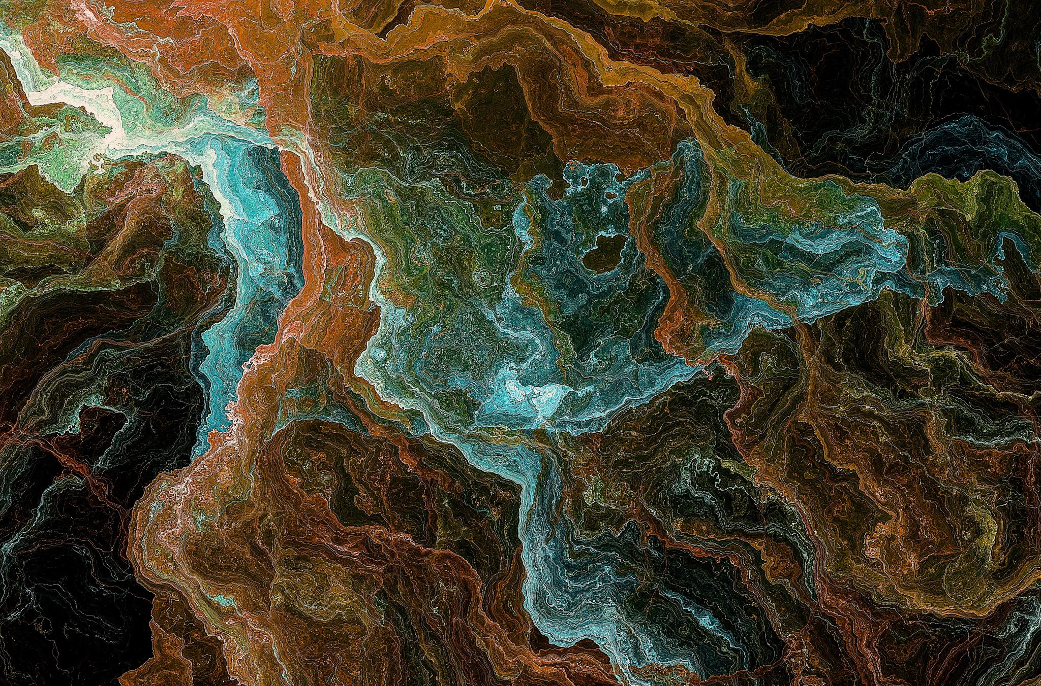
mmFace: 3D Face Recognition using RGB and Millimetre Wave Radar
Stergious Aji
Notes:
My name is Stergious Aji, and I’ll be presenting my Master’s research involving a novel 3D face recognition model harnessing RGB and millimetre wave radar

Slide 2
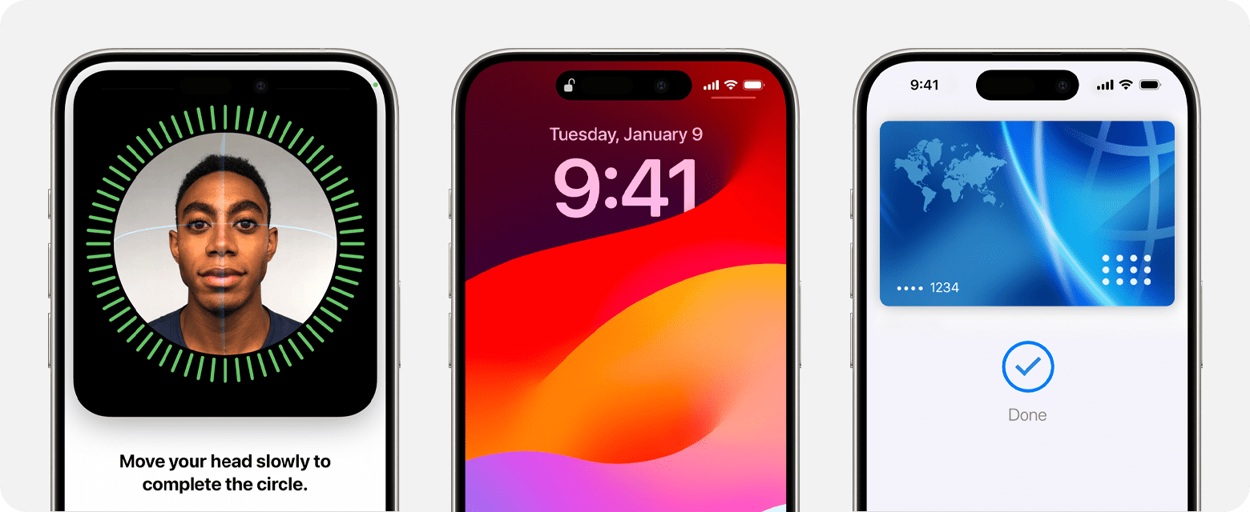
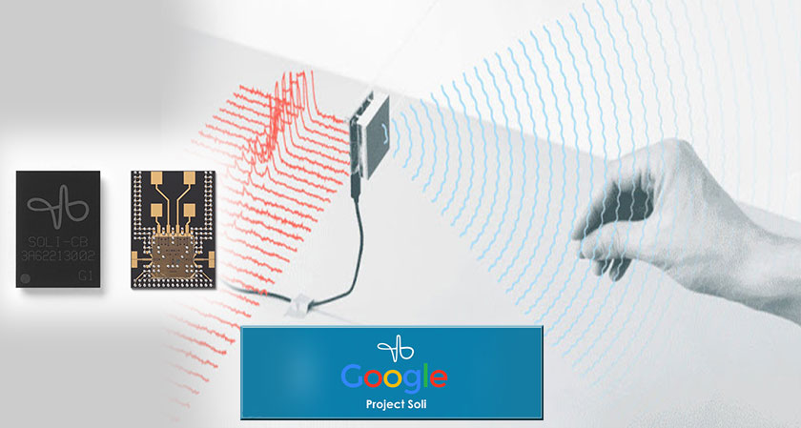
Motivations
Face recognition is a naturally accessible way of authenticating identity
Current systems like Apple’s Face ID employ NIR sensors that suffer from limitations
Apple uses costly proprietary hardware that are hidden behind patents
Compact, low-power mmWave sensing has excelled in autonomous vehicles
Google’s Soli Project successfully uses it for hand gesture recognition
Integrating mmWave radar with RGB images for 3D Face Recognition has not been explored
Notes:
Face recognition is a more naturally accessible way of verifying a person’s identity in comparison to passwords or even fingerprint sensors
Current systems like Apple’s Face ID employ near-infrared sensors that have certain limitations as they can be easily blocked by thin materials.
Face ID has also garnered a level of security that enables it be used for payment authentication.
However, Apple’s use of costly hardware and restrictive patents make it harder for smaller companies to adopt an equally compact and secure face recognition system.
Now the recent miniaturisation of millimetre wave radar tech has enhanced the autonomous vehicle domain due to its ability to permeate through environmental conditions like rain and fog unlike lidar sensors.
Google’s Soli project also successfully used it for hand gesture recognition in the Pixel 4 smartphones.
So we investigate integrating mmWave radar with colour info for 3D face recognition as this has not been explored yet.

Slide 3

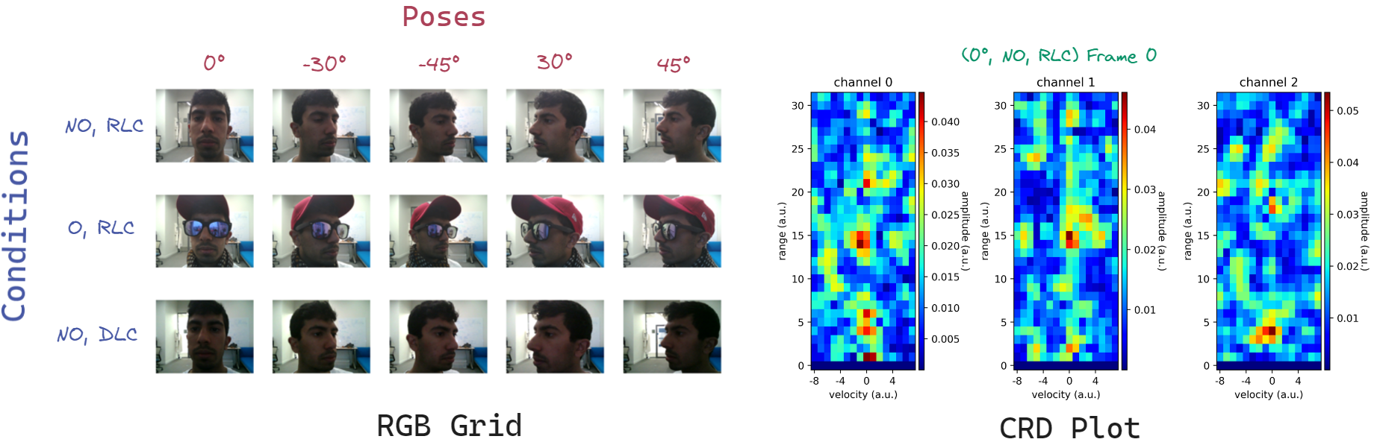
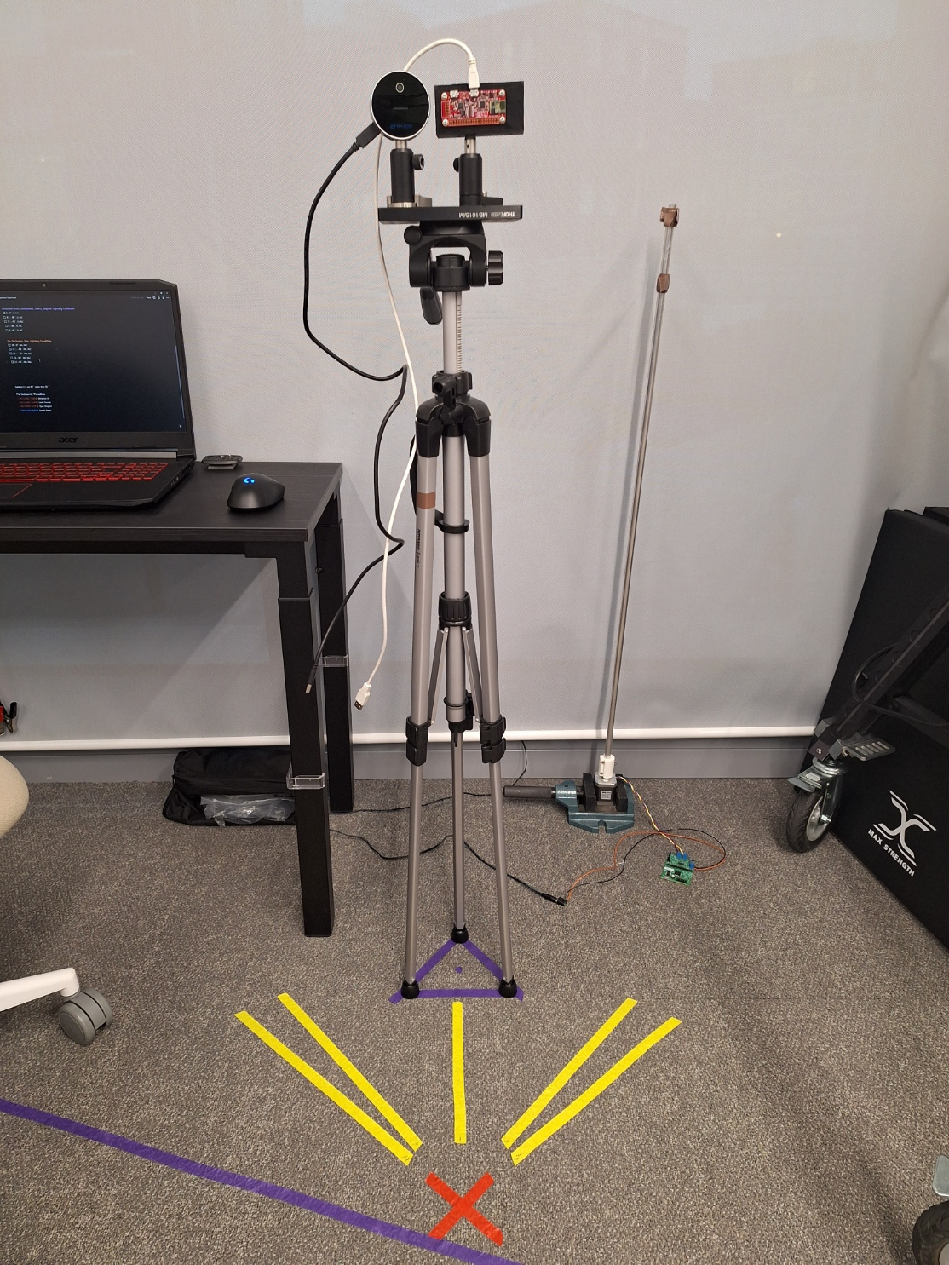
Data Acquisition
Intel Realsense RGB-D camera
Google’s Soli 60 GHz radar sensor
NO: No Occlusion
O: Occlusion
RLC: Regular Lighting Condition
DLC: Dim Lighting Condition
Notes:
As this is a relatively new area of research, there no suitable datasets are available to train our proposed model with
So we were compelled to curate our own.
We used the Intel Realsense to capture RGB-D images and Google’s Soli 60 GHz radar sensor for mmWave scans.
We collected facial scans from 21 participants as well as scans of printed faces on paper.
We decided to include 5 different facial poses, 2 lighting settings, and 2 occlusion scenarios. They are all laid out in the grid.
The occlusion scenarios involved the participant wearing common items of clothing that would obscure the face such as hats, sunglasses and scarves.
It has been shown that mmWaves are able to permeate through hair and fabric to directly reach the skin. We wanted to investigate if our system will be robust against face concealment.
Similarly, it was hypothesised that ambient lighting should not affect the system as the Soli uses its own waves to illuminate the target.

Slide 4
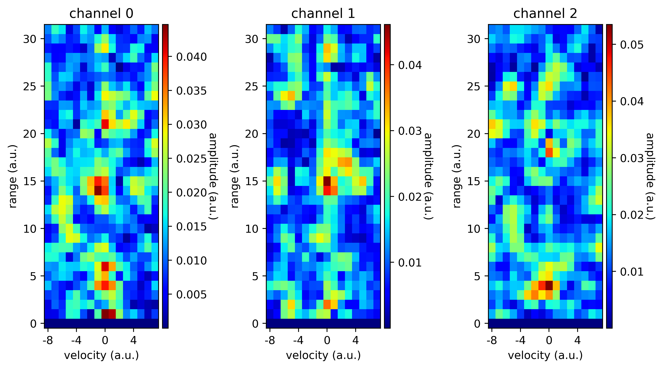
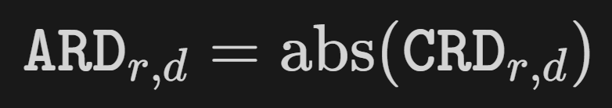
Data Preprocessing
Radar bursts received by the Soli underwent multiple FFTs
Raw signals discretised into Complex Range-Doppler (CRD) map
Magnitude of each complex value are taken to derive an Absolute Range-Doppler (ARD) map
Data augmentations applied to both modalities through horizontal and vertical reflections
Notes:
Following data acquisition, the data needed to be effectively preprocessed before using it to train our model.
The radar bursts underwent multiple stages of Fast Fourier Transforms
This basically discretises the raw signals into a Complex Range-Doppler map
To simplify computation, the magnitudes of each complex value are taken by simply taking the absolute value of each range and Doppler bin of the CRD.
Finally, data augmentations were applied to both modalities, being restricted to horizontal and vertical flipping.
These were carefully selected so that the layouts of the RGB images and mmWave signatures remained consistent.

Slide 5



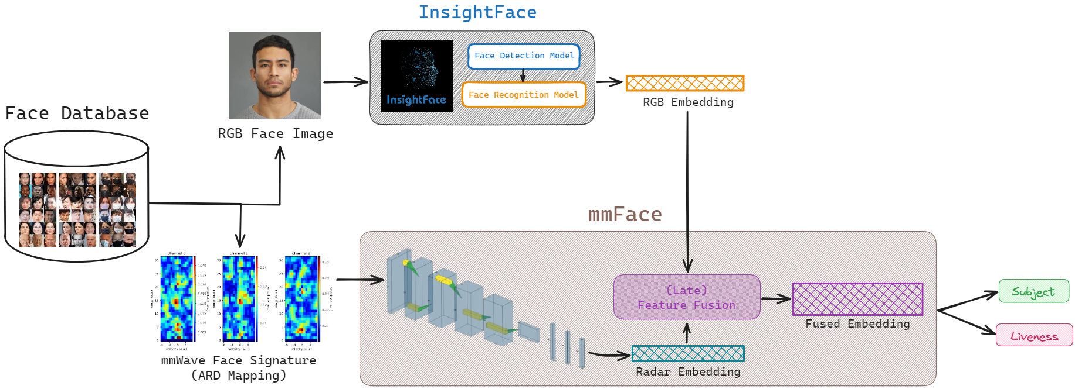
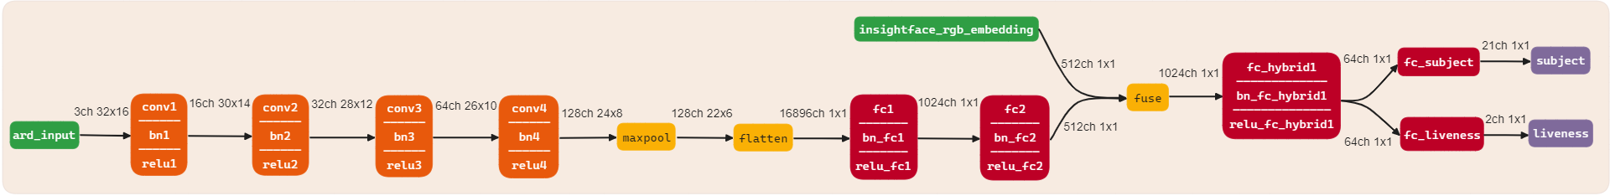
Model Architecture
Notes:
The neural network was trained and made through PyTorch
The first diagram shows the high-level workflow of our model used during training and inference.
The bottom diagram shows a more detailed architecture of each layer.
mmFace take 2 inputs: an RGB face image and the corresponding mmWave face signature.
The RGB features are extracted using a pretrained InsightFace model
Meanwhile, features are extracted from the mmWave data through a series of convolutional layers
Once we have both embeddings, they are fused to create a single embedding that integrates the textural information from the colour image and 3D structural features from the radar embedding.
Finally, the fused embedding is used to predict the subject identity and its liveness status.
Purpose of the liveness detection is to counter malicious actors that would try and trick the biometric authentication system using printed faces on paper.

Slide 6

EVALUATION

Slide 7
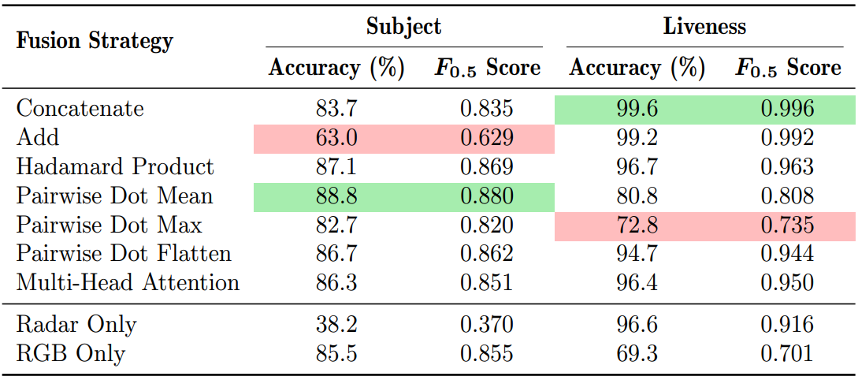
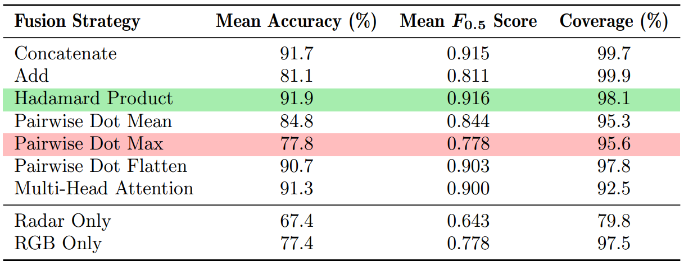
Zero-shot Classification Accuracy
Models assessed through zero-shot classification task against 8 reference embeddings (4 unseen subjects)
Best and worst performers highlighted in green and red
Concatenation emerges as best performer in liveness detection
Pairwise Dot Mean best at identity recognition
Averaged metrics favour Hadamard Product strategy
Table 1: Subject and liveness accuracies and $F_{0.5}$ measures for all seven fusion strategies along with the individual modalities
Table 2: Averaged accuracies and $F_{0.5}$ scores for all models with equal weighting applied to both prediction types.
Notes:
Our models were assessed through a 0-shot clf task against 8 reference embeddings that come from 4 subjects that were unseen during training.
The tables show the subject and liveness accuracies as well as the F measures for all 7 fusion strategies as well as the individual modalities.
A beta of 0.5 was used for the F-scores to prioritise precision over recall. Admitting incorrect identities is more detrimental than missing true matches within face recognition scenarios.
The best and worst performers are highlighted in green and red.
To summarise, concat emerges as most adept at detecting face liveness.
Pairwise dot then flatten strategy was the most effective for identity recognition
The second table shows the aggregated metrics applying equal weighting to subject and liveness predictions. Here the Hadamard product or elementwise multiplication of the vectors attained the best balance among the categories.
Next we will focus on the top-3 ranking strategies as they closely tag behind
These are the HP, Concat, and MHA

Slide 8
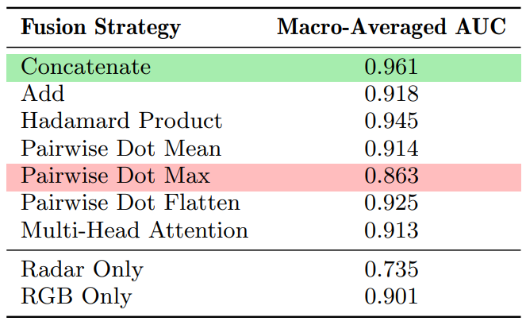
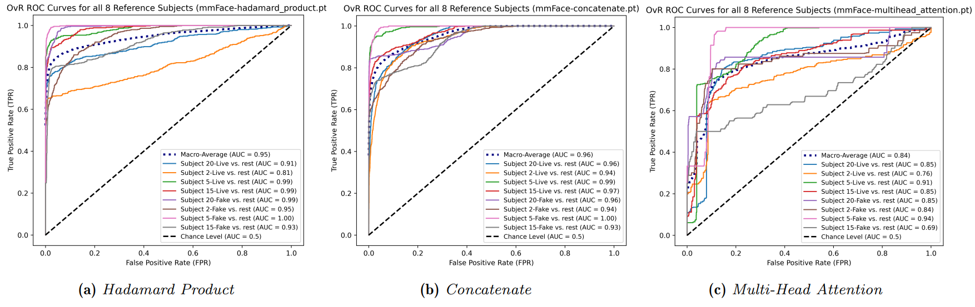
OvR ROC Curves and AUC
Notes:
Previous results were obtained using a decision threshold of 0.5 in order to discount embeddings that are equidistant to the reference vectors
But it is also important to assess the overall classifying ability of the models at varying thresholds which is what the ROC curves show. Curves reaching the top-left indicate a better classifier.
The area under curve metric is used to quantify this property
Clearly, the concatenation strategy produces the best classifier achieving the highest AUC of 0.96 macro-averaged across all 8 reference classes
Curves are tighter and in closer proximity to the top-left compared to HP
The MHA produces more dispersed curves demonstrating that the embedding it produces yields a higher number of false alarms than true positives.

Slide 9
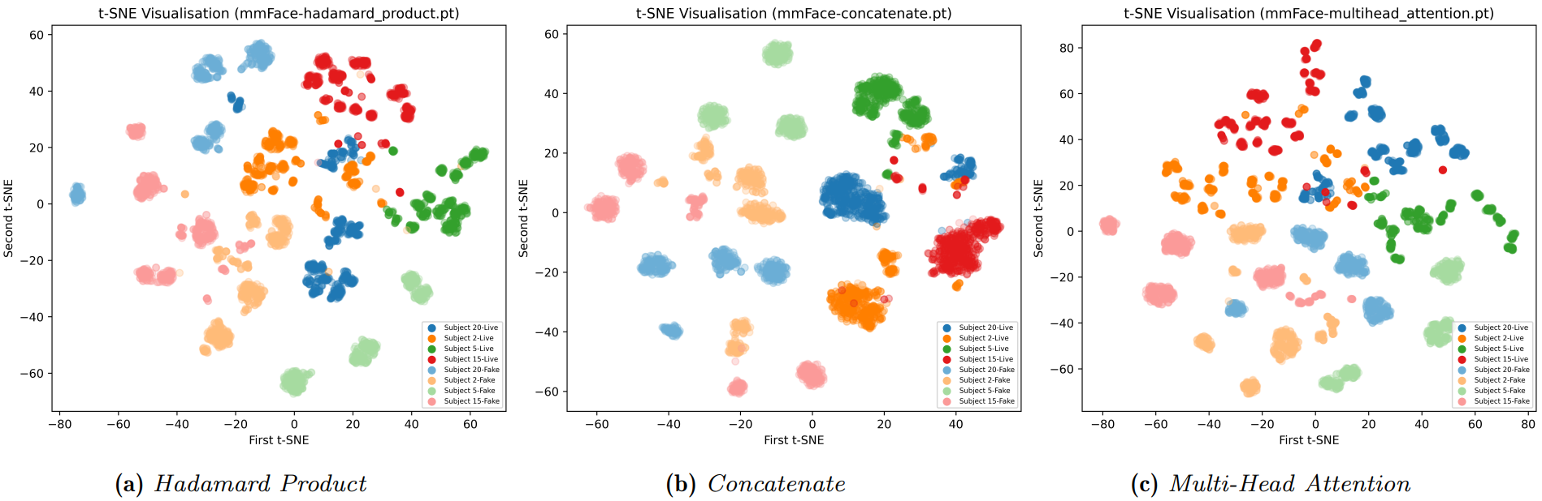

$t$-SNE Visualisations
Notes:
t-SNE dimensionality reduction is used to visualise the final layer features of every test data point.
The embeddings produced from the top-three ranking strategies are shown here colour coded by 4 subject identities. The lighter shade denotes fake subjects
Once again, the concat strategy produces a clearer separation between the data points. Especially giving a linear boundary between live and fake subjects.
The other 2 require more complex, non-linear boundaries.
The subject identities are more tightly clustered with the concatenation strategy with the other 2 producing more dispersed data points.
However, there is more confusion between subjects within the concat graph compared to the HP, explaining its lower subject prediction accuracy.

Slide 10
Discussion of Results
Concatenation found to yield the best-performing model overall
2nd highest in the aggregated general metrics
3rd highest under dim lighting only
Top ranking in occlusion-only scenarios
Hadamard Product fusion falls short in its classifying ability under different thresholds
Multi-Head Attention suffers from a low coverage rate
InsightFace RGB embeddings can discern real and fake photographs at a modest rate
The Soli radar sensor lacked precision for identity differentiation
Fusion models effectively use 3D information from the radar data to boost liveness detection
Notes:
Following the general metrics based on the full test collection, the models were tested against the isolated experiment subsets, namely non-occluding regular lighting, dim lighting as well as occluding settings.
Concatenation was subsequently found to yield the best-performing model overall achieving 2nd highest in the general category, 3rd highest under dim lighting only while being top ranking in the occlusion-only scenarios.
The HP fusion was found to fall short in its classifying ability across different thresholds due to its lower AUC.
MHA also suffered from low coverage of the test set obtaining the lowest rate out of all the fusion strategies.
Additionally, the performances of the non-hybrid models which used each modality separately showed that the InsightFace RGB embeddings could be used to discern real and fake photographs at a moderately decent rate.
Meanwhile, the Soli sensor lacked enough precision for effective identity differentiation.
However, the fusion models effectively improved on both modalities, leveraging the 3D info from the radar data to boost the liveness detection capabilities of InsightFace.

Slide 11

Achievements
Proposed a novel 3D face recognition model: mmFace
Can distinguish between unseen unique identities and verify their legitimacy
Gathered our own dataset featuring face scans of 21 participants under various conditions
Robust to environmental conditions and presence of face accessories
Counters 2D spoofing attacks and facial concealment using common items
Several fusion strategies analysed to identify concatenation as the most optimal across all conditions
Achieves 83.7% and 99.6% accuracy at predicting subject and liveness respectively, against a zero-shot classification task
Notes:
What did this project achieve?
Proposed a novel 3D face recognition model, mmFace, that can effectively distinguish between new unique identities as well as verify their legitimacy.
Gathered our own dataset featuring face scans of 21 participants under various conditions including: 5 facial poses, 2 lighting settings, and 2 occlusion scenarios.
The system is robust to environment conditions and facial poses.
It is also able to counter 2D spoofing attacks through printed face images on paper and facial concealment using common face accessories like hats, sunglasses and scarves
7 different feature fusion strategies were empirically investigated to find the most optimal method in blending the 2 modalities. Concatenation was found to be the best.
Achieves 83.7% acc at recognising subjects and 99.6% acc at detecting liveness against a zero-shot classification task.
Effectively demonstrating that unique identities are pushed to distinct regions in the high-D embedding space.

Slide 12

Future Work
Expand dataset size to 100 participants
Inconsistencies within the dim lighting condition should be mitigated through controlled lumen measurements
Diversifying the clothing apparel for more extreme cases of face concealment
A look into the effect of facial expressions
Leverage vision transformers employing a more rigorous self-attention mechanism
Additional fully connected layers for the Pairwise Dot Flatten strategy
Notes:
Our current model suffers from a certain number of limitations providing ample scope for future work:
Firstly, our dataset size is relatively small and should be expanded to 100 participants in future collection procedures.
This allows a bigger and more varied test set to really gauge the generalisability of our model to unseen faces.
The dim lighting experiment exposed subtle inconsistencies between face scans.
This was because collection procedure lacked strict control of the dimly lit environment. The experiment room allowed natural light that could not be fully blocked resulting in variations in captures taken at different times of the day.
Diversifying the clothing apparel to investigate more extreme cases of face concealment using ski masks or Halloween masks.
A look into the effect of facial expressions on the system.
With the bigger dataset, we can then leverage vision transformers that would employ a more rigorous self-attention mechanism. Our multi-head attention strategy did not take into account any positional encoding of the features.
Additional fully connected layers are needed for the Pairwise Dot Flatten strategy to compress the resulting 260 thousand-D feature vector in a more gradual process.

Slide 13
Thank you
Any Questions?

Slide 14
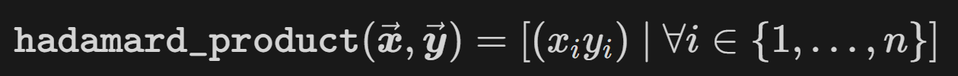
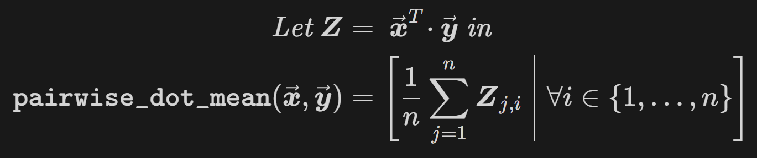
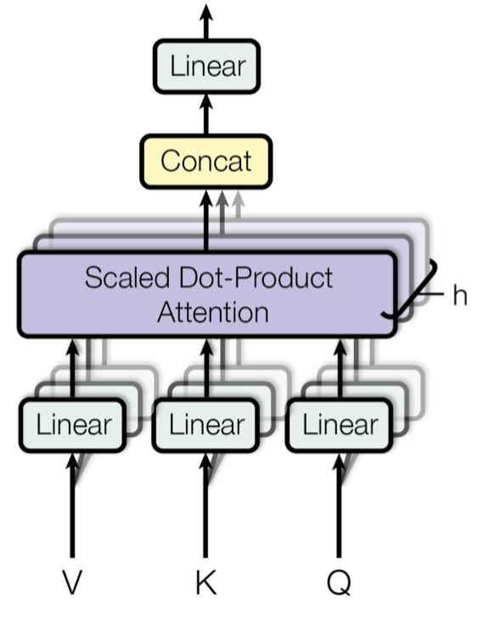
Feature-level Fusion Strategies
Concatenate
Add
Hadamard Product
Pairwise Dot Mean
Pairwise Dot Max
Pairwise Dot Mean
Multi-Head Attention

Slide 15
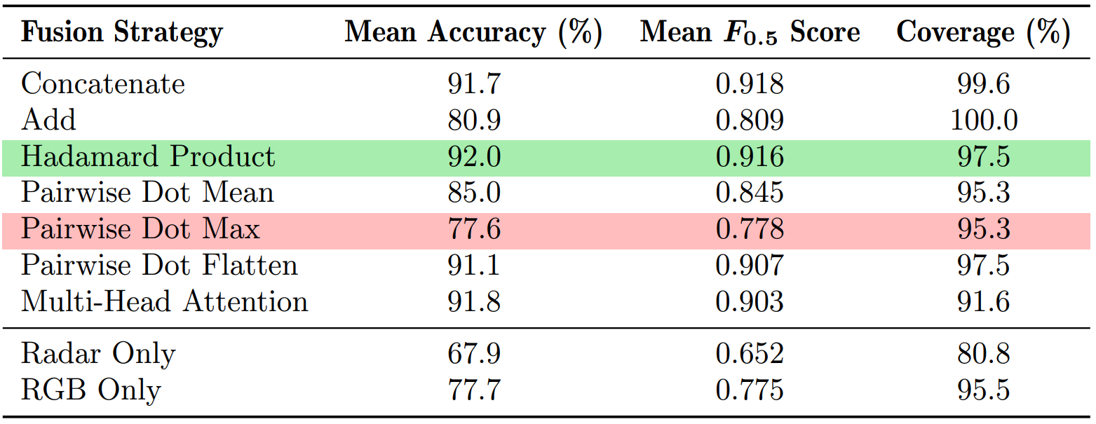
Non-occluding Regular Lighting Condition

Slide 16
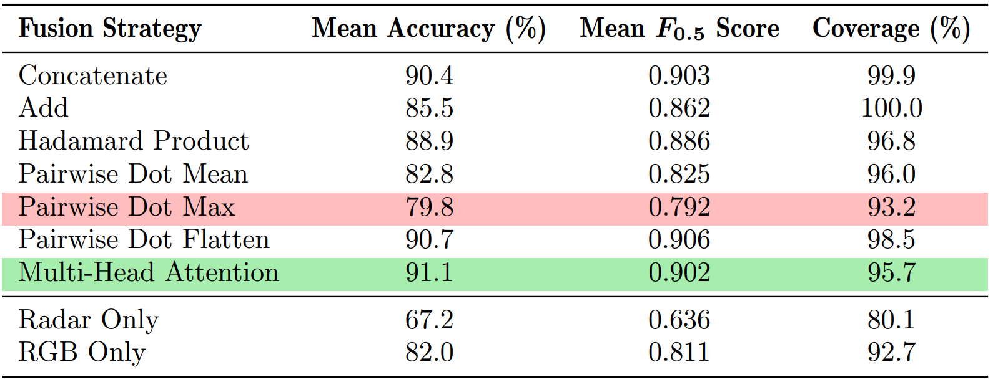
Dim Lighting Condition

Slide 17
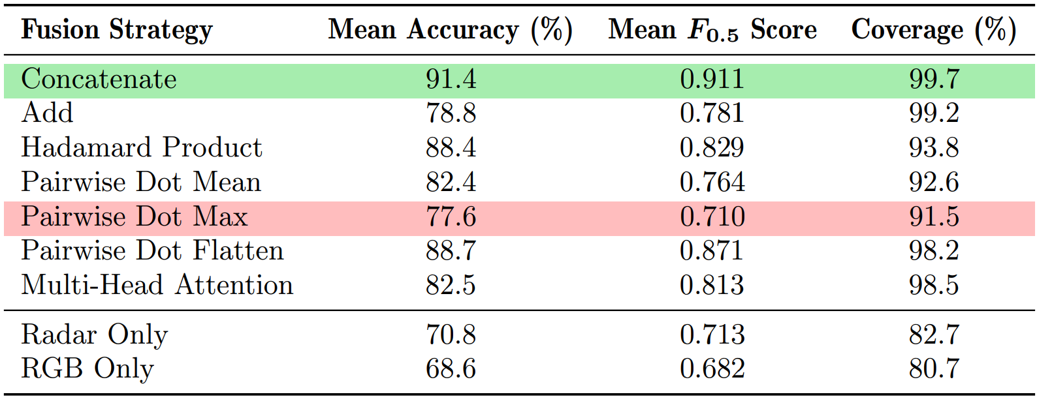
Occlusion

